Slide 1
Data Modelling
CP 224: DATABASE MANAGEMENT SYSTEM
Steve ‘25
Notes:
*

Slide 2
Outline
Data Models and Their Categories
History of Data Models
Schemas, Instances, and States
Three-Schema Architecture
Data Independence
DBMS Languages and Interfaces
Database System Utilities and Tools
Centralized and Client-Server Architectures
Classification of DBMSs
Notes:
*

Slide 3
Data Modelling
Data modelling is the process of creating a data model for the data to be stored in a database. This data model is a conceptual representation of Data objects, the associations between different data objects, and the rules.
Data modelling helps in the visual representation of data and enforces business rules, regulatory compliances, and government policies on the data. Data Models ensure consistency in naming conventions, default values, semantics, security while ensuring quality of the data.

Slide 4
Data Models
Data Model:
  A set of concepts to describe the structure of a database, the operations for manipulating these structures, and certain constraints that the database should obey.
Data Model Structure and Constraints:
  Constructs are used to define the database structure
  Constructs typically include elements (and their data types) as well as groups of elements (e.g. entity, record, table), and relationships among such groups
  Constraints specify some restrictions on valid data; these constraints must be enforced at all times
Notes:
The Data Model is defined as an abstract model that organizes data description, data semantics, and consistency constraints of data. The data model emphasizes on what data is needed and how it should be organized instead of what operations will be performed on data. Data Model is like an architect’s building plan, which helps to build conceptual models and set a relationship between data items.
The two types of Data Modeling Techniques are
Entity Relationship (E-R) Model
UML (Unified Modelling Language)
We will discuss them in detail later.
*

Slide 5
Why use Data Model?
Ensures that all data objects required by the database are accurately represented. Omission of data will lead to creation of faulty reports and produce incorrect results.
A data model helps design the database at the conceptual, physical and logical levels.
Data Model structure helps to define the relational tables, primary and foreign keys and stored procedures.
It provides a clear picture of the base data and can be used by database developers to create a physical database.
It is also helpful to identify missing and redundant data.
Though the initial creation of data model is labor and time consuming, in the long run, it makes your IT infrastructure upgrade and maintenance cheaper and faster.

Slide 6
Data Models (continued)
Data Model Operations:
  These operations are used for specifying database retrievals and updates by referring to the constructs of the data model.
  Operations on the data model may include;
    basic model operations
    (e.g. generic insert, delete, update)
    user-defined operations
    (e.g. compute_student_gpa, update_inventory)
Notes:
*

Slide 7
Categories of Data Models
Conceptual (high-level, semantic) data models:
  Provide concepts that are close to the way many users perceive data.
    (Also called entity-based or object-based data models.)
Physical (low-level, internal) data models:
  Provide concepts that describe details of how data is stored in the computer. These are usually specified in an ad-hoc manner through DBMS design and administration manuals
Implementation (representational) data models:
  Provide concepts that fall between the above two, used by many commercial DBMS implementations (e.g. relational data models used in many commercial systems).
Notes:
*

Slide 8
Schemas versus Instances
Database Schema:
  The description of a database.
  Includes descriptions of the database structure, data types, and the constraints on the database.
Schema Diagram:
  An illustrative display of (most aspects of) a database schema.
Schema Construct:
  A component of the schema or an object within the schema, e.g., STUDENT, COURSE.
Notes:
*

Slide 9
Schemas versus Instances
Database State:
  The actual data stored in a database at a particular moment in time. This includes the collection of all the data in the database.
  Also called database instance (or occurrence or snapshot).
    The term instance is also applied to individual database components, e.g. record instance, table instance, entity instance
Notes:
*

Slide 10
Database Schema vs. Database State
Database State:
  Refers to the content of a database at a moment in time.
Initial Database State:
  Refers to the database state when it is initially loaded into the system.
Valid State:
  A state that satisfies the structure and constraints of the database.
Notes:
*

Slide 11
Database Schema vs. Database State (continued)
Distinction
  The database schema changes very infrequently.
  The database state changes every time the database is updated.
Schema is also called intension.
State is also called extension.
Notes:
*

Slide 12

Example of a Database Schema

Slide 13

Example of a database state

Slide 14
Three-Schema Architecture
Proposed to support DBMS characteristics of:
  Program-data independence.
  Support of multiple views of the data.
Not explicitly used in commercial DBMS products, but has been useful in explaining database system organization
The goal is to separate the user applications from the physical database
Notes:
The goal of the three-schema architecture, is to separate the user applications from the physical database. In this architecture, schemas can be defined at the following three levels:
*

Slide 15
Three-Schema Architecture
Defines DBMS schemas at three levels:
  Internal schema at the internal level to describe physical storage structures and access paths (e.g indexes).
    Typically uses a physical data model.
  Conceptual schema at the conceptual level to describe the structure and constraints for the whole database for a community of users.
    Uses a conceptual or an implementation data model.
  External schemas at the external level to describe the various user views.
    Usually uses the same data model as the conceptual schema.
Notes:
The conceptual schema hides the details of physical storage structures and concentrates on describing entities, data types, relationships, user operations, and constraints.
*

Slide 16

The three-schema architecture

Slide 17
Three-Schema Architecture
Mappings among schema levels are needed to transform requests and data.
  Programs refer to an external schema, and are mapped by the DBMS to the internal schema for execution.
  Data extracted from the internal DBMS level is reformatted to match the user’s external view (e.g. formatting the results of an SQL query for display in a Web page)
Notes:
Notice that the three schemas are only descriptions of data; the actual data is stored
at the physical level only. In the three-schema architecture, each user group refers
to its own external schema. Hence, the DBMS must transform a request specified
on an external schema into a request against the conceptual schema, and then into
a request on the internal schema for processing over the stored database. If the
request is a database retrieval, the data extracted from the stored database must be
reformatted to match the user’s external view. The processes of transforming
requests and results between levels are called mappings.
*

Slide 18
Data Independence
The capacity to change the schema at one level of a database system without having to change the schema at the next higher level
  Logical Data Independence:
    The capacity to change the conceptual schema without having to change the external schemas and their associated application programs.
  Physical Data Independence:
    The capacity to change the internal schema without having to change the conceptual schema.
    For example, the internal schema may be changed when certain file structures are reorganized or new indexes are created to improve database performance
Notes:
*

Slide 19
Data Independence (continued)
When a schema at a lower level is changed, only the mappings between this schema and higher-level schemas need to be changed in a DBMS that fully supports data independence.
The higher-level schemas themselves are unchanged.
  Hence, the application programs need not be changed since they refer to the external schemas.
Notes:
*

Slide 20
DBMS Languages
Data Definition Language (DDL)
Data Manipulation Language (DML)
  High-Level or Non-procedural Languages: These include the relational language SQL
    May be used in a standalone way or may be embedded in a programming language
  Low Level or Procedural Languages:
    These must be embedded in a programming language
Notes:
A data definition language (DDL) is a computer language used to create and modify the structure of database objects in a database. CREATE, ALTER, DROP, and TRUNCATE.
SELECT, UPDATE, INSERT INTO
*

Slide 21
DBMS Languages
Data Definition Language (DDL):
  Used by the DBA and database designers to specify the conceptual schema of a database.
  In many DBMSs, the DDL is also used to define internal and external schemas (views).
  In some DBMSs, separate storage definition language (SDL) and view definition language (VDL) are used to define internal and external schemas.
    SDL is typically realized via DBMS commands provided to the DBA and database designers
Notes:
*

Slide 22
DBMS Languages
Data Manipulation Language (DML):
  Used to specify database retrievals and updates
  DML commands (data sublanguage) can be embedded in a general-purpose programming language (host language), such as COBOL, C, C++, or Java.
    A library of functions can also be provided to access the DBMS from a programming language
  Alternatively, stand-alone DML commands can be applied directly (called a query language).
Notes:
*

Slide 23
Types of DML
High Level or Non-procedural Language:
  For example, the SQL relational language
  Are “set”-oriented and specify what data to retrieve rather than how to retrieve it.
  Also called declarative languages.
Low Level or Procedural Language:
  Retrieve data one record-at-a-time;
  Constructs such as looping are needed to retrieve multiple records, along with positioning pointers.
  the user specifies what data is needed and how to get it
Notes:
*

Slide 24
DBMS Interfaces
User-friendly interfaces provided by a DBMS
Stand-alone query language interfaces
  Example: Entering SQL queries at the DBMS interactive SQL interface (e.g. SQL*Plus in ORACLE)
Programmer interfaces for embedding DML in programming languages
User-friendly interfaces
  Menu-based, forms-based, graphics-based, etc.
Notes:
*

Slide 25

Typical DBMS Component Modules

Slide 26
Centralized and
Client-Server DBMS Architectures
Centralized DBMS:
  Combines everything into single system including- DBMS software, hardware, application programs, and user interface processing software.
  User can still connect through a remote terminal – however, all processing is done at centralized site.
Notes:
The idea is to define specialized servers with specific functionalities. For example, it is possible to connect a number of PCs
or small workstations as clients to a file server that maintains the files of the client machines. Another machine can be designated as a printer server by being connected to various printers;
*

Slide 27

A Physical Centralized Architecture

Slide 28
Basic 2-tier Client-Server Architectures
Specialized Servers with Specialized functions
  Print server
  File server
  DBMS server
  Web server
  Email server
Clients can access the specialized servers as needed
Notes:
*

Slide 29

Logical two-tier client server architecture

Slide 30
Clients
Provide appropriate interfaces through a client software module to access and utilize the various server resources.
Clients may be diskless machines or PCs or Workstations with disks with only the client software installed.
Connected to the servers via some form of a network.
  (LAN: local area network, wireless network, etc.)
Notes:
*

Slide 31
DBMS Server
Provides database query and transaction services to the clients
Relational DBMS servers are often called SQL servers, query servers, or transaction servers
Applications running on clients utilize an Application Program Interface (API) to access server databases via standard interface such as:
  ODBC: Open Database Connectivity standard
  JDBC: for Java programming access
Client and server must install appropriate client module and server module software for ODBC or JDBC
Notes:
*

Slide 32
Two Tier Client-Server Architecture
A client program may connect to several DBMSs, sometimes called the data sources.
In general, data sources can be files or other non-DBMS software that manages data.
Other variations of clients are possible: e.g., in some object DBMSs, more functionality is transferred to clients including data dictionary functions, optimization and recovery across multiple servers, etc.
Notes:
*

Slide 33
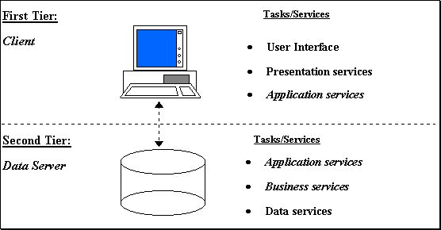
Two Tier Client-Server Architecture

Slide 34
Three Tier Client-Server Architecture
Common for Web applications
Intermediate Layer called Application Server or Web Server:
  Stores the web connectivity software and the business logic part of the application used to access the corresponding data from the database server
  Acts like a conduit for sending partially processed data between the database server and the client.
Three-tier Architecture Can Enhance Security:
  Database server only accessible via middle tier
  Clients cannot directly access database server
Notes:
*

Slide 35

Three-tier client-server architecture

Slide 36
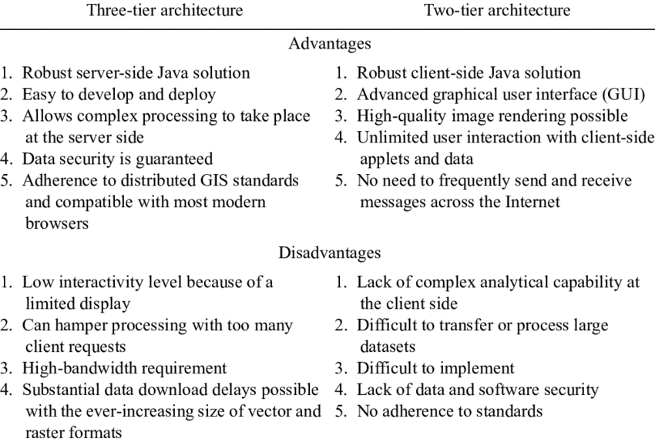
3Tier vs 2Tier Client-Server Architecture

Slide 37
Classification of DBMSs
Based on the data model used
  Traditional: Relational, Network, Hierarchical.
  Emerging: Object-oriented, Object-relational.
Other classifications
  Single-user (typically used with personal computers)
  vs. multi-user (most DBMSs).
  Centralized (uses a single computer with one database)
  vs. distributed (uses multiple computers, multiple databases)
Notes:
*

Slide 38
Variations of Distributed DBMSs (DDBMSs)
Homogeneous DDBMS
Heterogeneous DDBMS
Federated or Multidatabase Systems
Distributed Database Systems have now come to be known as client-server based database systems because:
  They do not support a totally distributed environment, but rather a set of database servers supporting a set of clients.
Notes:
*

Slide 39
Cost considerations for DBMSs
Cost Range: from free open-source systems to configurations costing millions of dollars
Examples of free relational DBMSs: MySQL, PostgreSQL, others
Commercial DBMS offer additional specialized modules, e.g. time-series module, spatial data module, document module, XML module
  These offer additional specialized functionality when purchased separately
  Sometimes called cartridges (e.g., in Oracle) or blades
Different licensing options: site license, maximum number of concurrent users (seat license), single user, etc.
Notes:
*

Slide 40
History of Data Models
Hierarchical Model
Network Model
Relational Model
Entity Relationship Model
Object-oriented Data Models
Object-Relational Models
Notes:
*

Slide 41
History of Data Models
Hierarchical Data Model:
  Initially implemented in a joint effort by IBM and North American Rockwell around 1965. Resulted in the IMS family of systems.
  IBM’s IMS product had (and still has) a very large customer base worldwide
  Hierarchical model was formalized based on the IMS system
  Other systems based on this model: System 2k (SAS inc.)
Notes:
*

Slide 42
Hierarchical Model
Advantages:
  Simple to construct and operate
  Corresponds to a number of natural hierarchically organized domains, e.g., organization (“org”) chart
  Language is simple:
    Uses constructs like GET, GET UNIQUE, GET NEXT, GET NEXT WITHIN PARENT, etc.
Disadvantages:
  Navigational and procedural nature of processing
  Database is visualized as a linear arrangement of records
  Little scope for "query optimization"
Notes:
*

Slide 43
History of Data Models
Network Model:
  The first network DBMS was implemented by Honeywell in 1964-65 (IDS System).
  Adopted heavily due to the support by CODASYL (Conference on Data Systems Languages) (CODASYL - DBTG report of 1971).
  Later implemented in a large variety of systems - IDMS (Cullinet - now Computer Associates), DMS 1100 (Unisys), IMAGE (H.P. (Hewlett-Packard)), VAX -DBMS (Digital Equipment Corp., next COMPAQ, now H.P.).
  Representing objects and their relationships
Notes:
A network model is a database model that is designed as a flexible approach to representing objects and their relationships. A unique feature of the network model is its schema, which is viewed as a graph where relationship types are arcs and object types are nodes
*

Slide 44
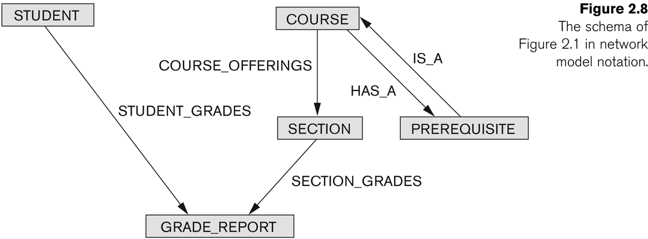
Example of Network Model Schema

Slide 45
Network Model
Advantages:
  Network Model is able to model complex relationships and represents semantics of add/delete on the relationships.
  Can handle most situations for modeling using record types and relationship types.
  Language is navigational; uses constructs like FIND, FIND member, FIND owner, FIND NEXT within set, GET, etc.
    Programmers can do optimal navigation through the database.
Notes:
*

Slide 46
Network Model
Disadvantages:
  Navigational and procedural nature of processing
  Database contains a complex array of pointers that thread through a set of records.
    Little scope for automated “query optimization”
Notes:
*

Slide 47
History of Data Models
Relational Model:
  Proposed in 1970 by E.F. Codd (IBM), first commercial system in 1981-82.
  Now in several commercial products (e.g. DB2, ORACLE, MS SQL Server, SYBASE, INFORMIX).
  Several free open source implementations, e.g. MySQL, PostgreSQL
  Currently most dominant for developing database applications.
  SQL relational standards: SQL-89 (SQL1), SQL-92 (SQL2), SQL-99, SQL3, …
  Chapters 5 through 11 describe this model in detail
Notes:
*

Slide 48
History of Data Models
Object-oriented Data Models:
  Several models have been proposed for implementing in a database system.
  One set comprises models of persistent O-O Programming Languages such as C++ (e.g., in OBJECTSTORE or VERSANT), and Smalltalk (e.g., in GEMSTONE).
  Additionally, systems like O2, ORION (at MCC - then ITASCA), IRIS (at H.P.- used in Open OODB).
  Object Database Standard: ODMG-93, ODMG-version 2.0, ODMG-version 3.0.
  Chapters 20 and 21 describe this model.
Notes:
*

Slide 49
History of Data Models
Object-Relational Models:
  Most Recent Trend. Started with Informix Universal Server.
  Relational systems incorporate concepts from object databases leading to object-relational.
  Exemplified in the latest versions of Oracle-10i, DB2, and SQL Server and other DBMSs.
  Standards included in SQL-99 and expected to be enhanced in future SQL standards.
  Chapter 22 describes this model.
Notes:
*

